Slide 1
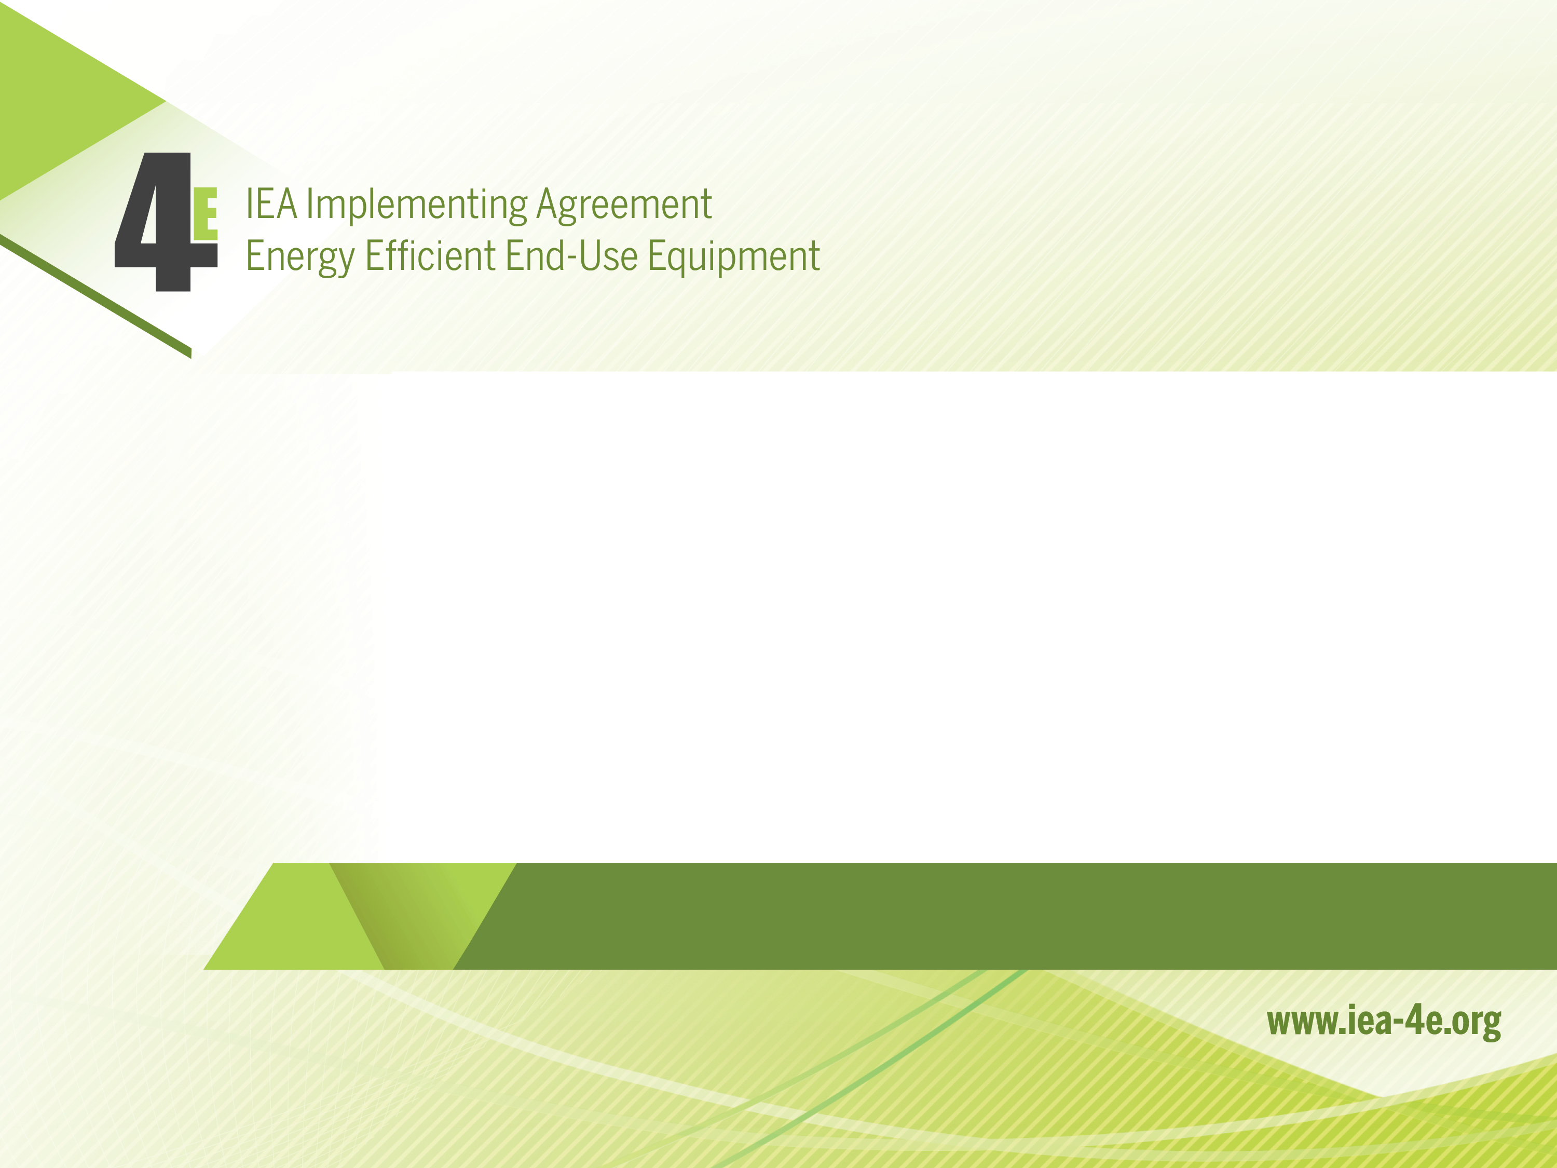
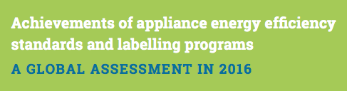

Slide 2
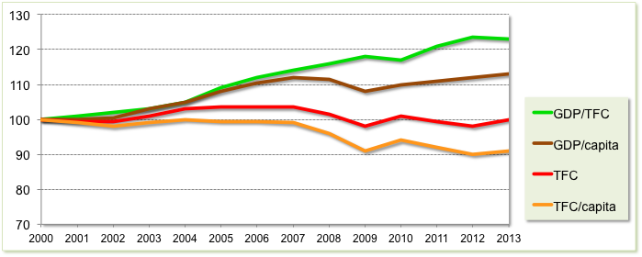
Energy Efficiency & Economic Development
Energy efficiency has led to a decoupling of economic and energy growth.
In 2013, OECD energy consumption = 2000 levels, while GDP expanded by 26%.
Source: IEA, Energy Efficiency Market Report, 2015

Slide 3
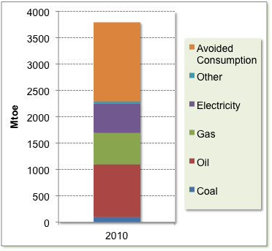
Energy Efficiency – the FIRST FUEL
In 11 IEA countries*, energy savings exceeded the output from any other single fuel source in 2010
The result of cumulative investment in energy efficiency since 1974
*Australia, Denmark, Finland, France, Germany, Italy, Japan, Netherlands, Sweden, the United Kingdom and the United States
Source: IEA, Energy Efficiency Market Report 2013

Slide 4
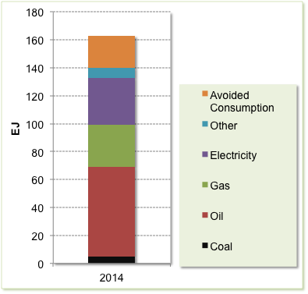
The Multiple Benefits of Energy Efficiency
In 2014, all IEA countries energy efficiency investment since 1990 led to…....
22 EJ avoided fuel consumption
32 EJ avoided primary energy
USD 550 billion savings to consumers
190 Mtoe of energy imports replaced by locally supplied efficiency
820 MtCO₂ in greenhouse gas emissions reductions
Energy efficiency programs for appliances and equipment have made a significant contribution to these achievements........
Source: IEA, Energy Efficiency Market Report, 2015

Slide 5
Achievements of EESL programs
This report provides an authoritative summary of past achievements of national energy efficiency standards and labelling (EESL) programs for appliances & equipment.
EESL programs include:
  Minimum energy performance standards (MEPS)
  Mandatory comparison labels (usually stars or numbers)
  Endorsement labels (the best in class)
EESL programs operate in >80 countries, covering >50 different types of equipment in all sectors.
They provide the cornerstone of most national energy efficiency and climate change mitigation programs.

Slide 6
Summary of policy measures, by measure type for selected countries, 2013
Growth in all program types
Growth in all regions
Source: Harrington, L., J. Brown, and M. Caithness, Energy standards and labelling programs throughout the world in 2013, 2014, Energy Effcient Strategies

Slide 7
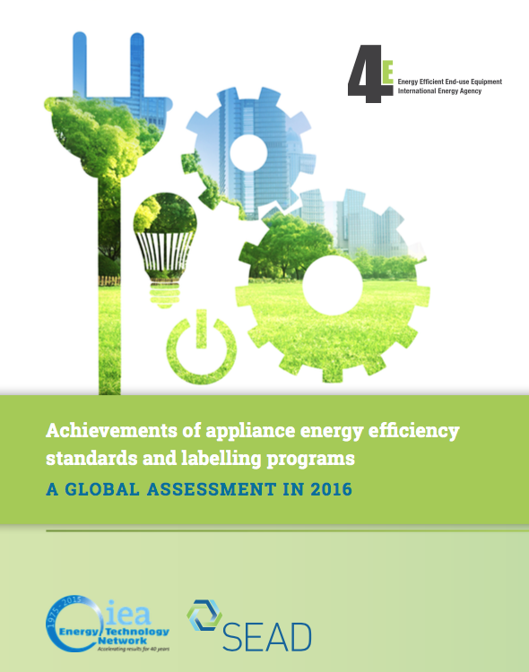
Report Coverage
First published in 2015 - updated and expanded in 2016.
Based on evidence published in over 150 detailed impact studies.
Covers EESL programs in 50 countries spanning over 30 different product types.

Slide 8
Findings: Efficiency & Energy Savings
Products
The energy efficiency of major appliances have increased at more than 3x the underlying rate of technology improvement in countries with EESL programs.
One-off improvements of more than 30% have been observed.
National Energy Consumption
The most mature national EESL programs covering a broad range of products are estimated to save between 10% and 25% of national or relevant sectoral energy consumption.

Slide 9
Findings: Cost-benefit
In all programs reviewed, the national benefits outweighed the additional costs by a ratio of at least 3 to 1.
Note: Impacts take account of likely rebound effect.
Net cost savings to US consumers (USD billion)
Source: Meyers, S., A. Williams, and P. Chan, Energy and Economic Impacts of U.S. Federal Energy and Water Conservation Standards Adopted From 1987 Through 2013, 2014, LBNL, USA: Berkely, California.

Slide 10
Findings: Cost of Greenhouse Gas Reductions
EESL programs deliver energy and CO₂ reductions while also reducing total costs.
This compares extremely favourably with the cost of other clean energy options.
Supports the conclusion: end-use efficiency measures offer the least cost pathway to energy and CO₂ emission reductions.
See following figure.

Slide 11
Marginal emission reduction costs for the global energy system, 2050
Source: IEA, Energy Technology Perspectives: Scenarios and Strategies to 2050, 2008, International Energy Agency/ OECD

Slide 12
Findings: Impact on Appliance Prices
Appliances and equipment covered by EESL programs have not only dramatically improved in efficiency over the past 20 years, but are also cheaper to purchase.
While EESL programs may have caused small changes in prices close to the implementation of new energy efficiency measures, they appear to have had little long-term impact on appliance price trends.
EESL programs are very good at fostering innovation.
Findings suggest that it is often cost-effective to be more ambitious in setting performance thresholds.

Slide 13
Price and energy trends for clothes washers in the USA
Price Trend
Source: Nadel, S. and A. deLaski, Appliance Standards: Comparing Predicted and Observed Prices, 2013

Slide 14
Findings: Additional Impacts
EESL programs deliver very significant co-benefits such as:
  Job creation
  Improved air quality
  Savings in health costs
These may be very large and further enhance the cost-benefit case for EESL programs.
The contribution made by increased energy efficiency in these areas can be sufficiently large in their own right to justify EESL programs in some jurisdictions.

Slide 15
Conclusions
EESL programs have substantially reduced energy use and CO₂ emissions - very much cheaper than could have been achieved by other clean energy supply options.
This conclusion takes into account any rebound effect.
Improved health from higher thermal comfort and/or avoided air pollution; job creation and energy security - provide added justification for these programs.
All EESL programs have the potential to expand in scope and ambition to deliver more energy and CO₂ savings.
Governments should note these findings when determining investment options and priorities for meeting energy demand.

Slide 16

Acknowledgements
This report is based on research undertaken for the IEA Implementing Agreement for a Co-operative Programme on Energy Efficient End-Use Equipment (4E).
Thanks to the Super-Efficient Equipment and Appliance Deployment (SEAD) initiative and the large number of experts that have provided input to this meta-data analysis.

